Slide 1
DIGITAL CORRECTION IN SMALL ROOMS
A Perceptual Study Evaluating 3 Small Critical-Listening Room Calibration Systems

Slide 2
Who?
Technician, Engineer, Programmer
Time in Small Project Studios (and NYC in general)
Work at the Clive Davis Institute
Notes:
So who am I?
*******ADVANCE******ADVANCE******ADVANCE******ADVANCE******ADVANCE
I’m a technican, an engineer, and a programmer
While I currently work as a technician
*******ADVANCE
I’ve also worked in a couple of studios as an engineer
Mainly small project studios
I’ve found that this is a pretty common layout for studios in NYC
*******ADVANCE
Currently tech at Clive Davis
Where the students , like many young musicians are making music in their apartment or dorm room, which has little or no acoustic treatment

Slide 3
What?
Evaluating 3 Room Correction software products in small critical-listening rooms
Quantitative (Frequency Response)
Qualitative (Preference and Aural Characteristics)
Notes:
For this thesis
*******ADVANCE******ADVANCE******ADVANCE******ADVANCE******ADVANCE
The question I worked to answer was how do 3 different digital correction systems perform in 3 different small critical listening rooms, *******ADVANCE******ADVANCE******ADVANCE******ADVANCE******ADVANCE
I evaluated both the Quantitative performance, by way of measuring frequency responses and comparing them
*******ADVANCE******ADVANCE******ADVANCE******ADVANCE******ADVANCE
and Qualitative performance by way of a survey sent to expert listeners.

Slide 4
Why?
Accessibility
City Living
Notes:
Why am I doing this
*******ADVANCE******ADVANCE******ADVANCE******ADVANCE******ADVANCE
because Digital correction is many times more accessible than acoustic treatment
it is Simpler to set up, more space efficient compared to installing acoustic absorbers, diffusers, or bass traps
*******ADVANCE******ADVANCE******ADVANCE******ADVANCE******ADVANCE
In an apartment there’s only so much that you can do to treat a room, you can’t change the room shape or material
Additionally, since it is software you can recalibrate it when you move apartments.

Slide 5
Why Now?
Work From Home
Last Comprehensive Study in 2009
The Subjective and Objective Evaluation of Room Correction Products
Notes:
So Why now?
*******ADVANCE******ADVANCE******ADVANCE******ADVANCE******ADVANCE
Our favorite buzzword of 2020, working from home showed us how many industries and jobs could be done remotely with minimal impact to quality and productivity, but as all City-based producers know, critical listening at home comes with a host of problems.
While headphones provide a more controlled listening experience, every time they are put on the slight differences in how they couple to the outer ear change the frequency response slightly. In addition, headphones are not accurate for mixing content that will be heard on speakers, since listening on headphones has no speaker crosstalk and removes the phantom center channel you hear when listening on a stereo pair of speakers. This is particularly troublesome in higher frequencies, where the crosstalk can have an even more significant effect on the recording’s overall balance.
*******ADVANCE******ADVANCE******ADVANCE******ADVANCE******ADVANCE
Last comprehensive study of different commercial correction systems was conducted by Olive et al. in 2009, before IK Multimedia’s ARC or Sonarworks were available.

Slide 6
Previous Study - The Subjective and Objective Evaluation of Room Correction Products
The Subjective and Objective Evaluation of Room Correction Products – Olive et al
Design and Evaluation of Digital Filters Applied to Loudspeaker/Room Equalization - Rubak, P. & Johansen, L. G.
Subjective Investigations of Inverse Filtering - Norcross, S. G., Soulodre, G. A., & Lavoie, M. C.
Notes:
Alongside Olive et al’s 2009 study on room correction and filtering are
*******ADVANCE******ADVANCE******ADVANCE******ADVANCE******ADVANCE
Rubak and Johnasen’s 2000 study
and
*******ADVANCE******ADVANCE******ADVANCE******ADVANCE******ADVANCE
Norcross , Soulodre, & Lavoie’s 2004 study
But olive et al’s study was most relevant and inspirational to mine so I’ll discuss that one in detail

Slide 7
Previous Study - The Subjective and Objective Evaluation of Room Correction Products
Subjective and Objective
Comparison of 5 room correction products
Audyssey Room Equalizer,
Anthem Statement D2 Processor
Harman International Room Correction 1 and Room Correction 2
Lyngdorf DPA-1
3 Pieces of Program Material
Jennifer Warnes’ “Bird on a Wire”
Tracy Chapman’s “Fast Car”
James Taylor’s “That’s Why I’m Here”
Impulse responses were recorded in 6 different listening seats
Listeners Asked for Preference and subjective characteristic ratings
Notes:
*******ADVANCE******ADVANCE******ADVANCE******ADVANCE******ADVANCE
Olive et al’s study was the primary inspiration for this study,
I was especially inspired by how collecting both objective frequency response data and subjective survey responses allowed them to correlate the two
*******ADVANCE******ADVANCE******ADVANCE******ADVANCE******ADVANCE
The room correction products used were all pretty modern at the time (some were even prototypes), but are no now outdated or no longer available
*******ADVANCE******ADVANCE******ADVANCE******ADVANCE******ADVANCE
3 pieces of program material were used
Jennifer Warnes’ “Bird on a Wire”
Tracy Chapman’s “Fast Car”
James Taylor’s “That’s Why I’m Here”
Because the material had reliably revealed spectral differences among different loudspeakers and equalizations in previous testing.
Impulse responses were recorded in 6 different listening seats using an omni directional DBX reference microphone.
*******ADVANCE******ADVANCE******ADVANCE******ADVANCE******ADVANCE
Listeners were asked for their preference of each of the 6 systems (5 correction systems + uncorrected) , as well as asked to rate each correction system on these subjective characteristics

Slide 8
Previous Study - The Subjective and Objective Evaluation of Room Correction Products
Conclusions
Listeners preferred the room that was least colored, harsh, thin, and the most full and neutral.
It was observed that all except 1 system was able to fix a resonance at 48 hz and 2 added unnecessary boosts at 80 hz.
Shortcomings
All listeners were employees of Harman International
Testing and Evaluation were done in 1 room
Musical Examples were too similar
Notes:
*******ADVANCE******ADVANCE******ADVANCE******ADVANCE******ADVANCE
*******ADVANCE******ADVANCE******ADVANCE******ADVANCE******ADVANCE
*******ADVANCE******ADVANCE******ADVANCE******ADVANCE******ADVANCE
*******ADVANCE******ADVANCE******ADVANCE******ADVANCE******ADVANCE
It was concluded from the data that the listeners preferred the room which was considered the least colored, harsh, thin, and the most full and neutral.
And it was also clear from the objective data that they all performed somewhat similarly, THAT all but 1 fixed a resonance at 48Hz, and that 2 added unnecessary boosts at 80Hz
There are, however, a few things to be improved over this study
*******ADVANCE******ADVANCE******ADVANCE******ADVANCE******ADVANCE
All listeners were Harman International employees with listening training (but perhaps not production or mixing experience).
Testing and evaluation were only done in one room
Musical examples were not that varied

Slide 9
This Study - DIGITAL CORRECTION IN SMALL ROOMS
Objective Analysis
Subjective Study
Collect impulse responses before and after correction
Turned the impulse responses into difference plots to see similarities and differences
Create Corrected and Uncorrected versions of recordings using a KU-100 Binaural head
Collect preference rankings and subjective characteristic ratings from expert listeners
Notes:
For my study I took a similar approach and did both an
*******ADVANCE******ADVANCE******ADVANCE******ADVANCE******ADVANCE
objective and
*******ADVANCE******ADVANCE******ADVANCE******ADVANCE******ADVANCE
subjective analysis,
*******ADVANCE******ADVANCE******ADVANCE******ADVANCE******ADVANCE
Like olive et al's study I took impuse responses of the rooms before and after correction,
with the primary goal of seeing what the
*******ADVANCE******ADVANCE******ADVANCE******ADVANCE******ADVANCE
correction systems were doing the same and what they were doing differently
*******ADVANCE******ADVANCE******ADVANCE******ADVANCE******ADVANCE
For my subjective testing, I created a survey in which listeners would listen to 4 binaural recordings of a musical excerpt played a particular room each processed with one of 3 correction systems or unprocessed
*******ADVANCE******ADVANCE******ADVANCE******ADVANCE******ADVANCE
They would then rank the 4 systems (3 correction and 1 uncorrected) in terms of preference and also rate each system on a 5 point scale across 5 criteria:
Brightness, Bass Balance, Left-Right Balance, Stereo Width, and Clarity

Slide 10
Source Material
Sine Sweep for collecting Impulse Responses
1 Second Long
15 Hz to 20 KHz
Dual Mono
Recorded sweep was deconvolved with the original to get the impulse response
Notes:
For my source material
*******ADVANCE******ADVANCE******ADVANCE******ADVANCE******ADVANCE
For the objective component I used a 1 second long 15Hz to 20KHz, dual Mono Sine Sweep which I played back and recorded in each room and deconvolved with the original sweep to get my impulse responses

Slide 11
Source Material
3 Songs
Bird on a Wire
Mr. Brightside
LOYALTY.
Notes:
*******ADVANCE******ADVANCE******ADVANCE******ADVANCE******ADVANCE
For the subjective component of my study, I took from olive et al the idea of using 3 songs for testing, as well as one of the actual tracks used
The songs were:
*******ADVANCE******ADVANCE******ADVANCE******ADVANCE******ADVANCE
Bird on a Wire by Jennifer Warnes from Famous Blue Raincoat
*******ADVANCE******ADVANCE******ADVANCE******ADVANCE******ADVANCE
Mr. Brightside by The Killers from Hot Fuss
*******ADVANCE******ADVANCE******ADVANCE******ADVANCE******ADVANCE
Loyalty by Kendrick Lamar from DAMN.
The latter 2 are recommended reference tracks’s from Izotope’s reference track library for Hip Hop and Rock

Slide 12
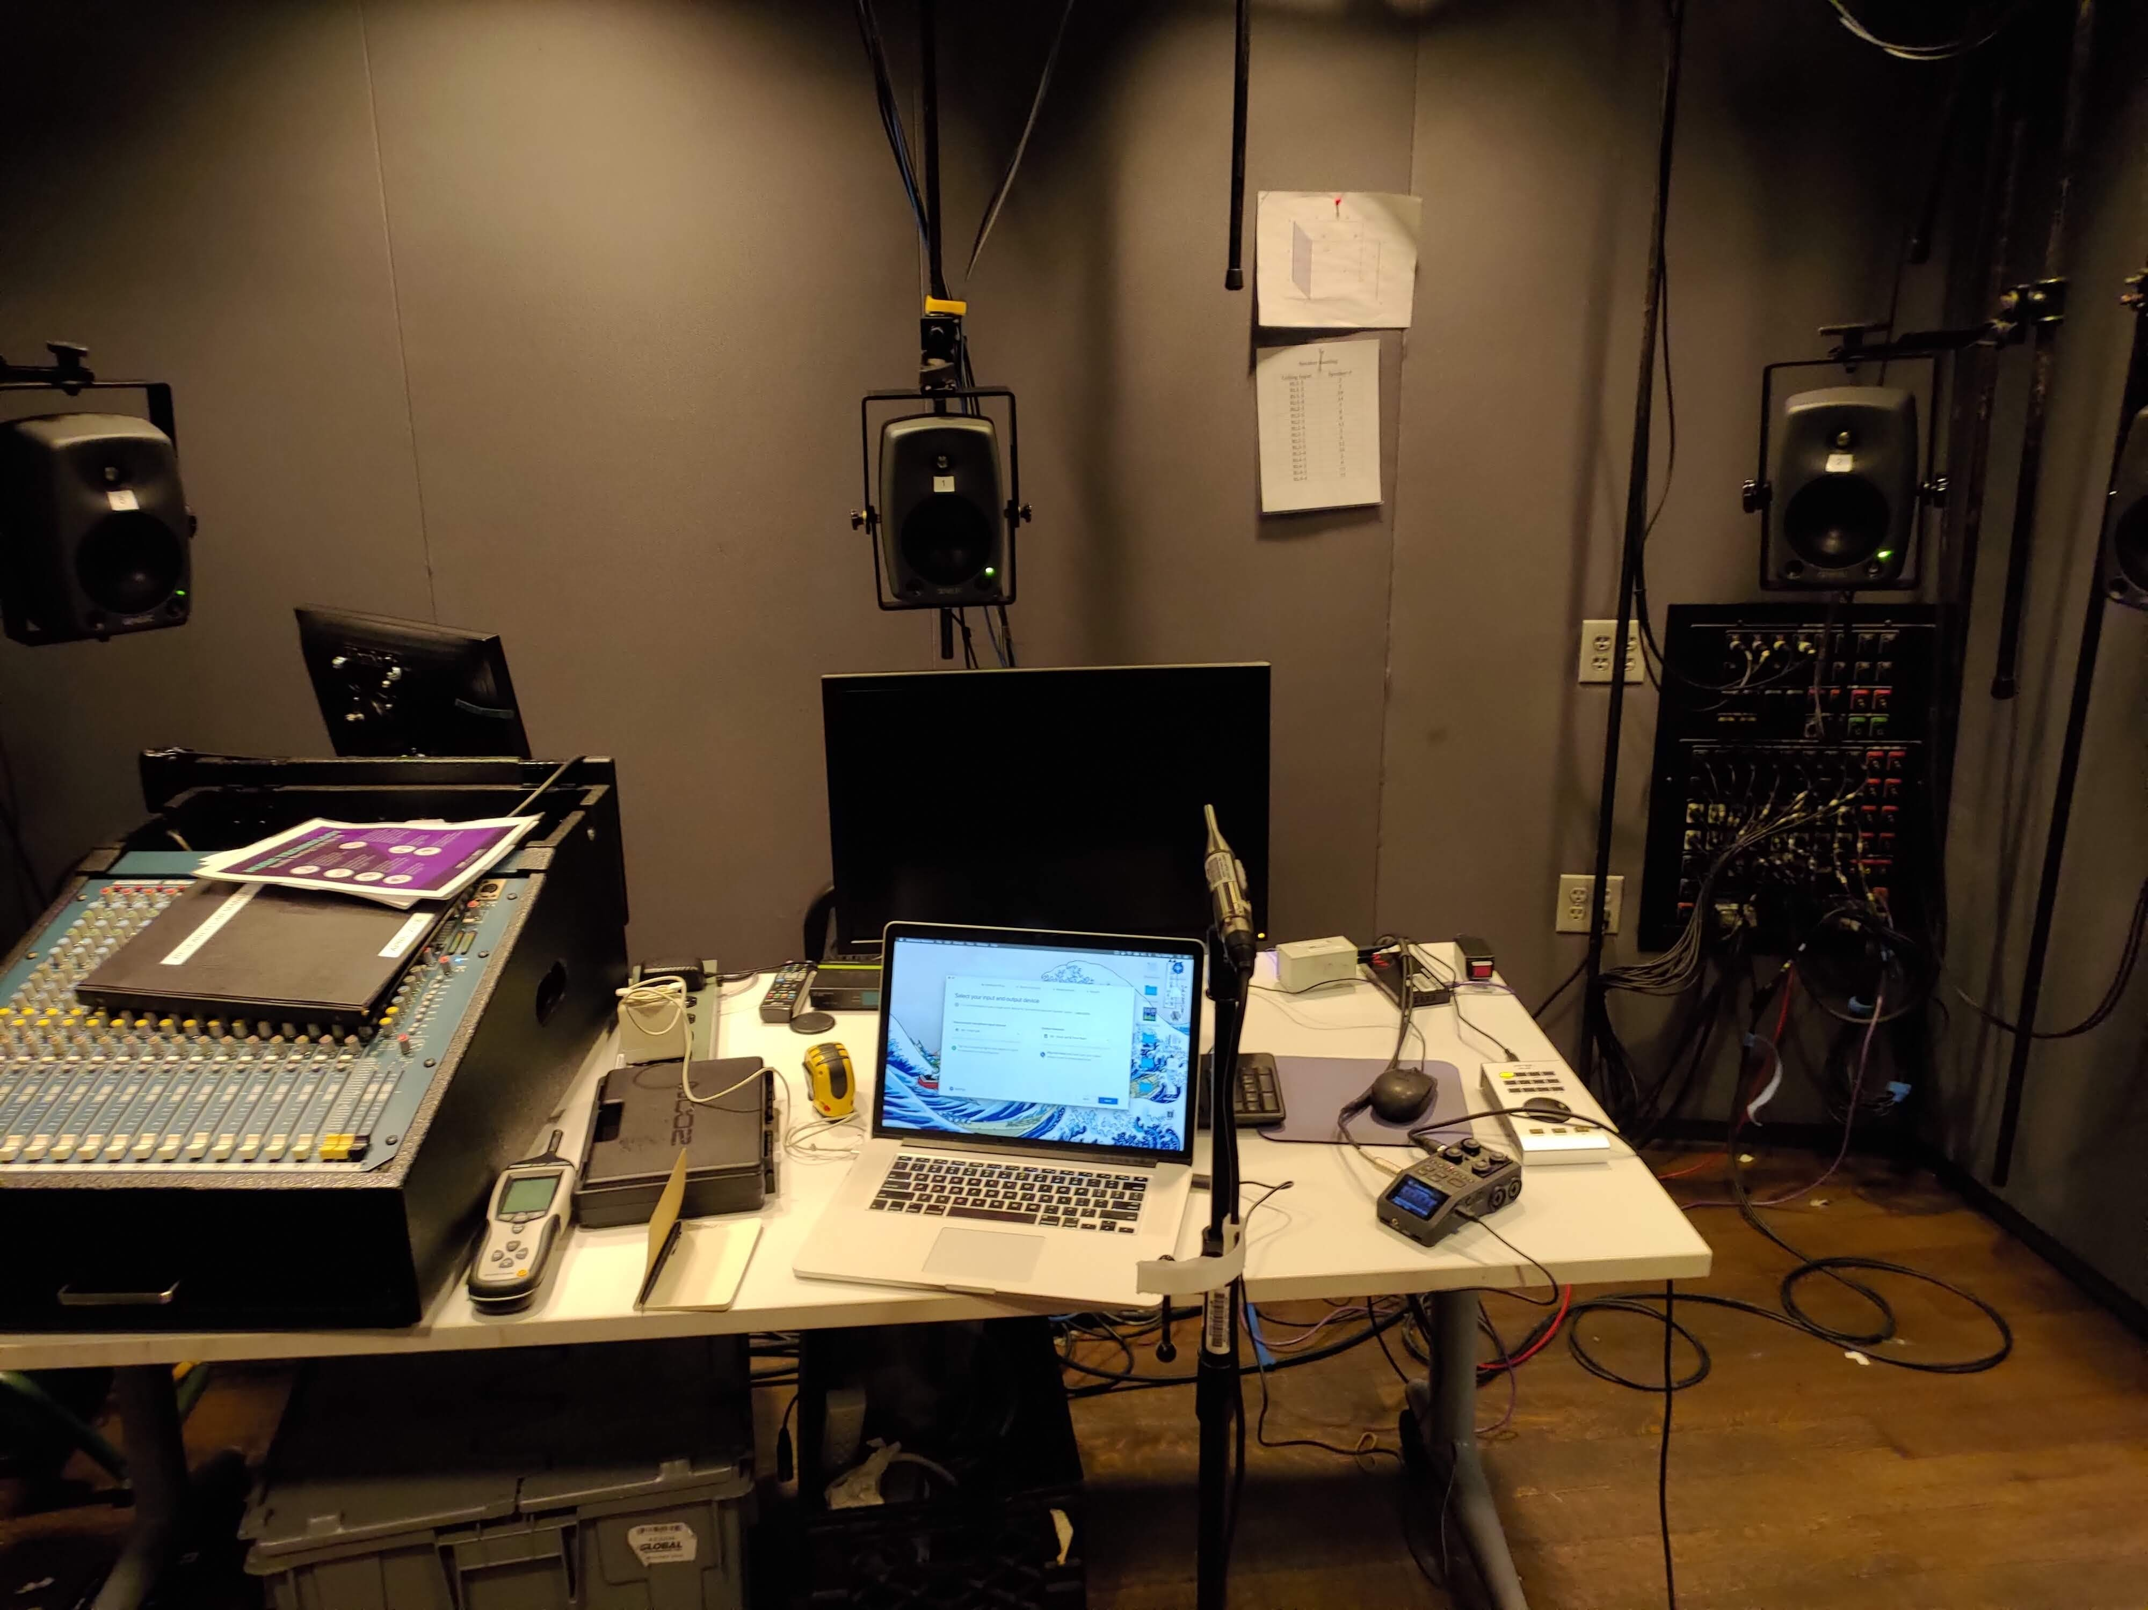
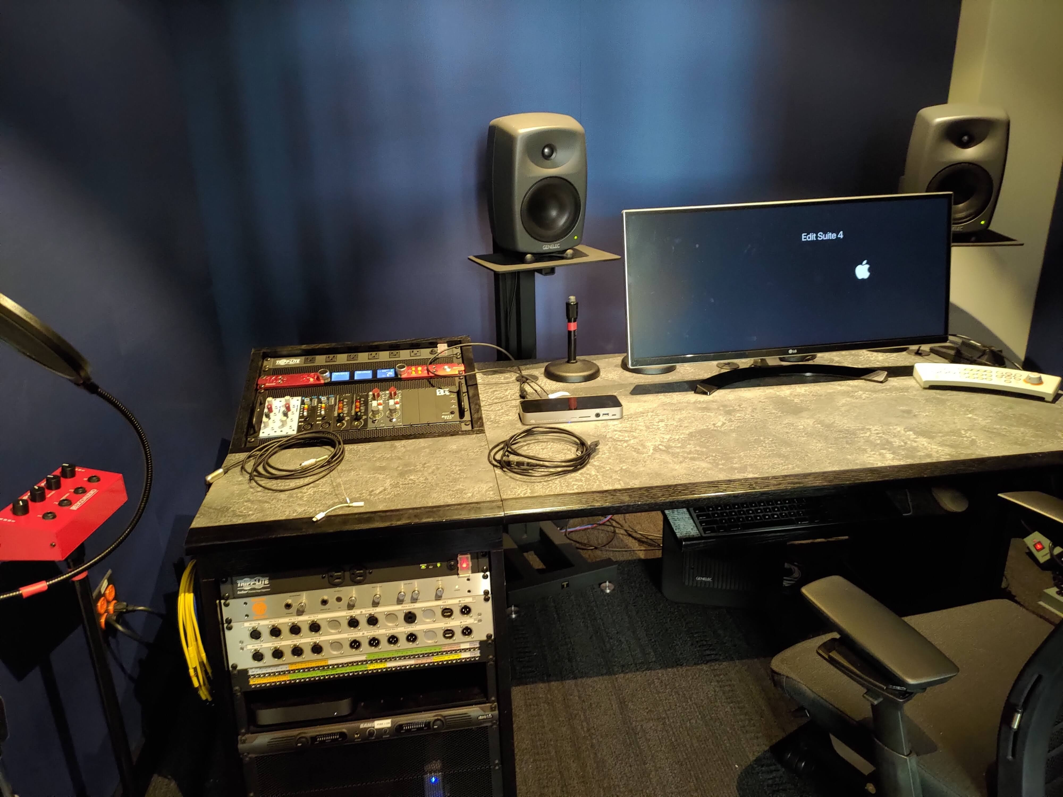
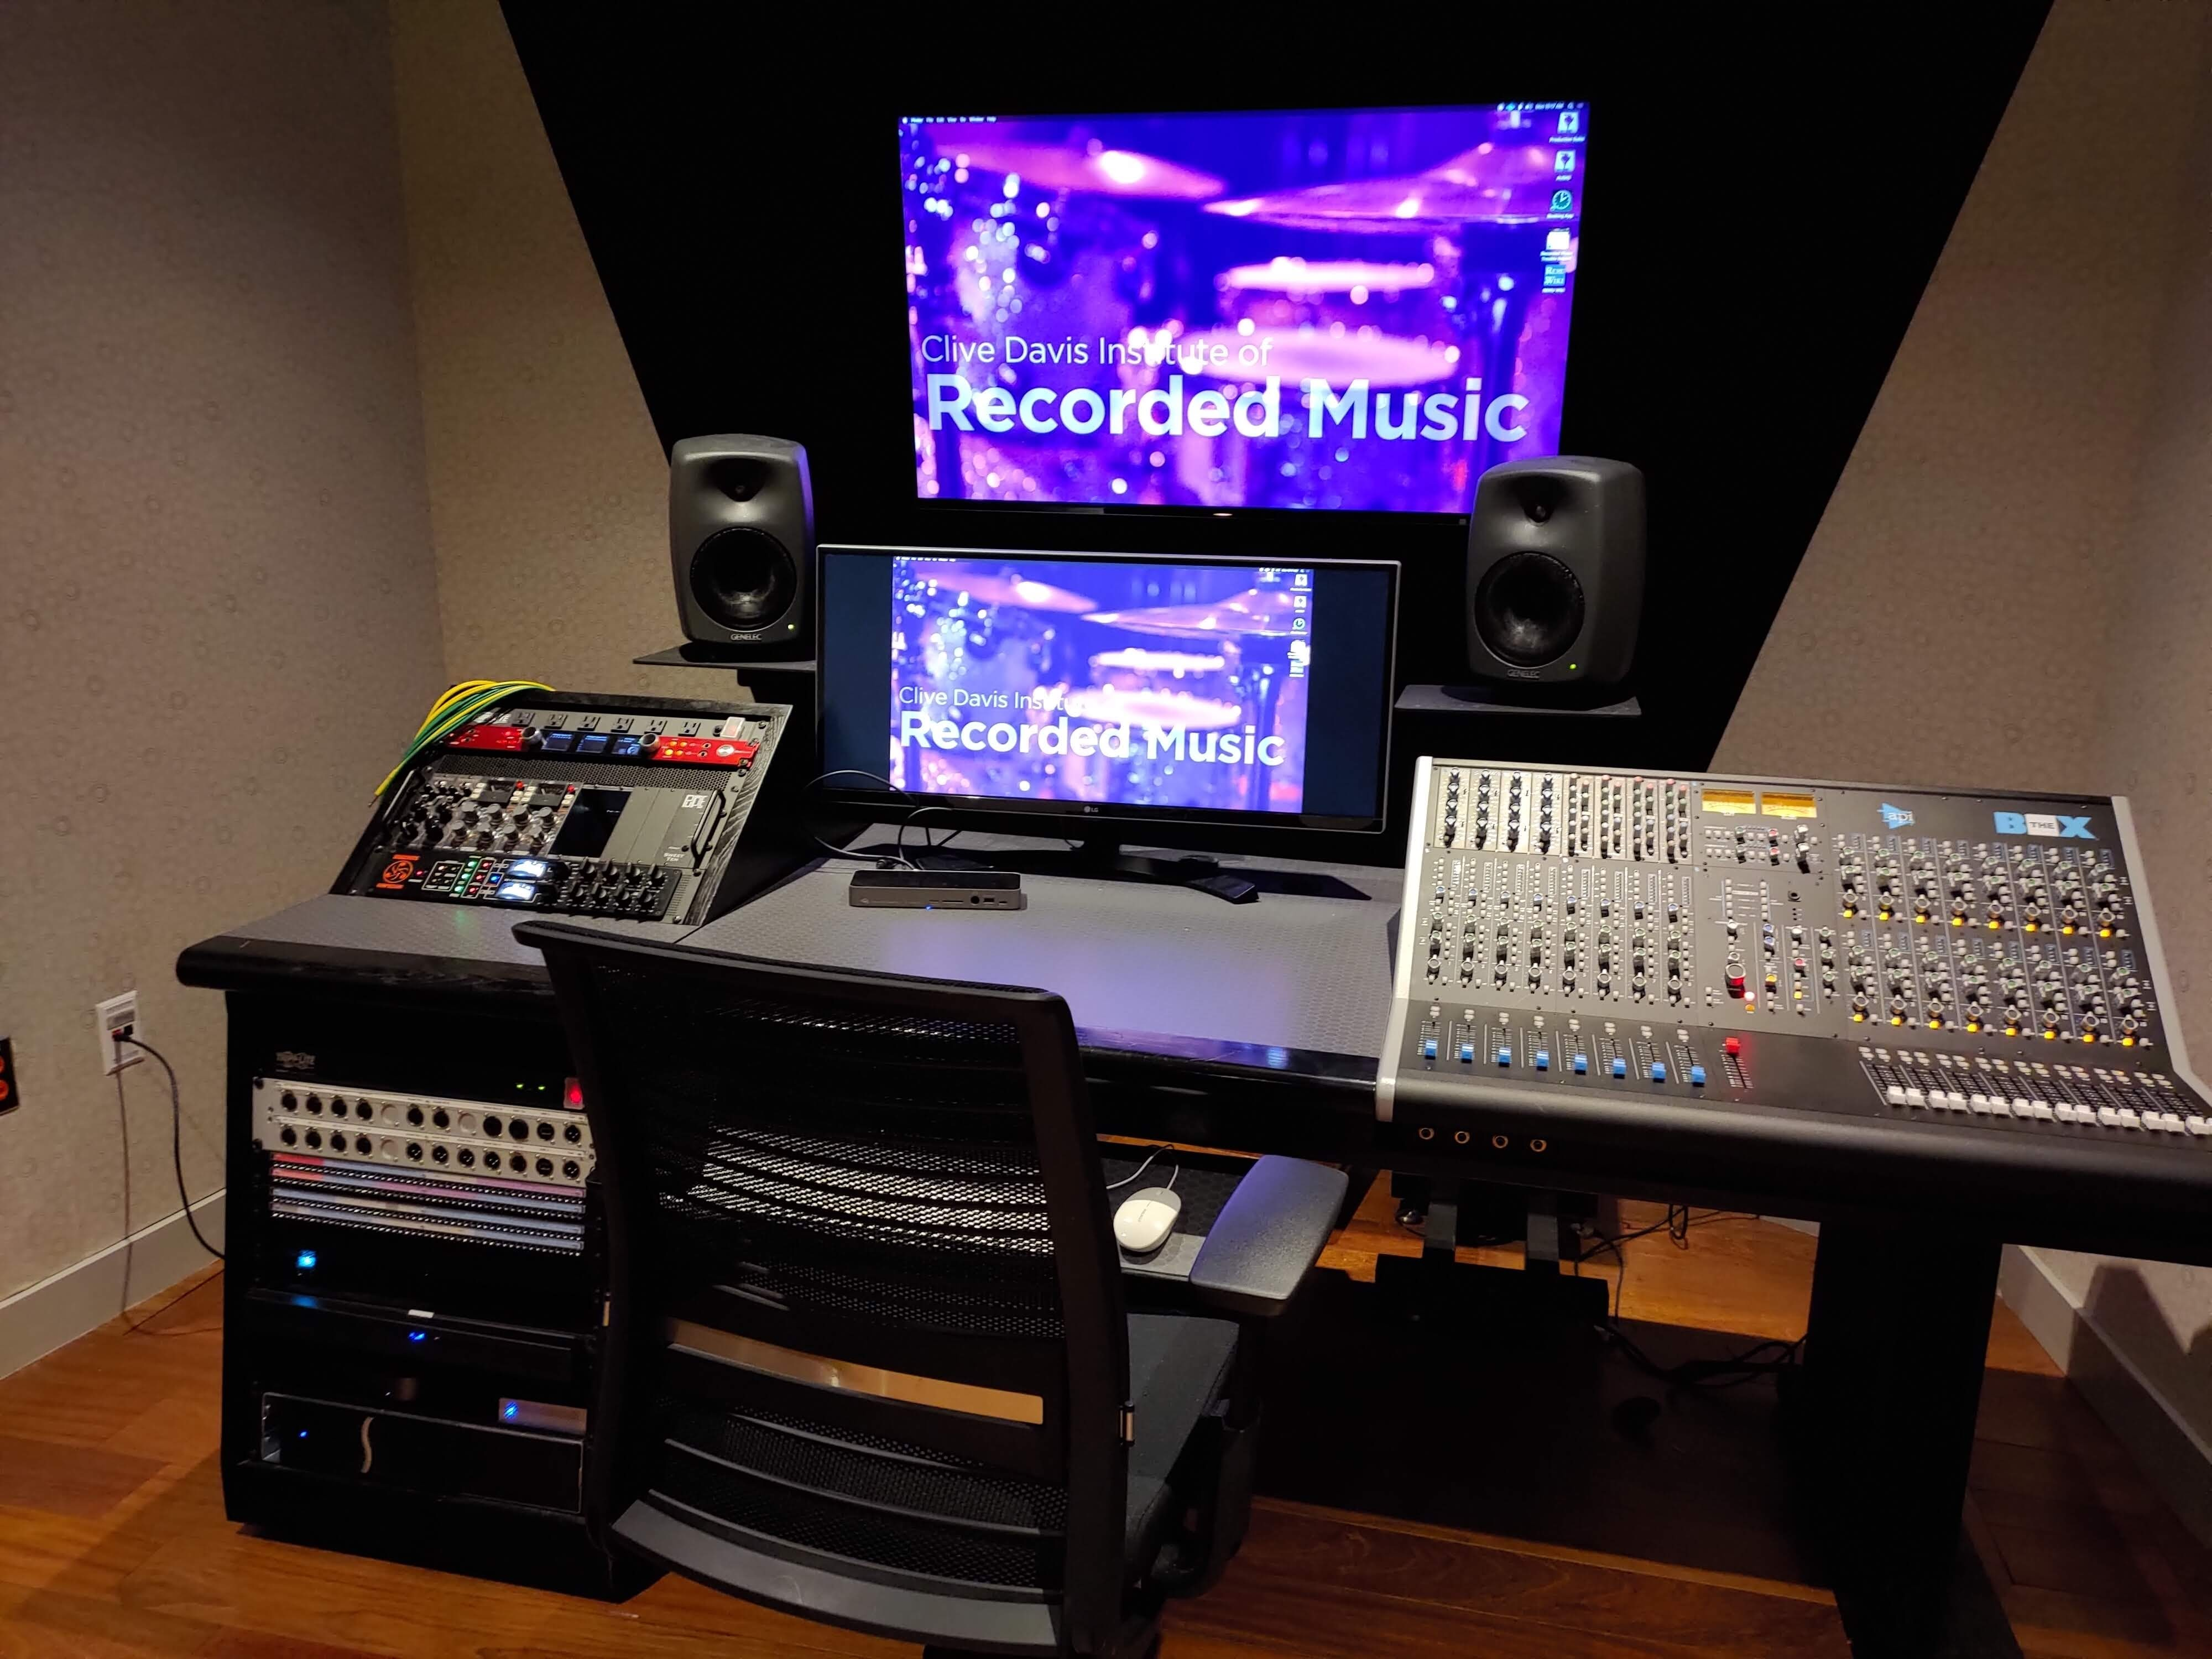
Components
3 Rooms
Immersive Audio Research Lab
Edit Suite 4
Production Suite B
Notes:
Improving on Olive et al’s study, I included 3 small critical listening spaces in my study
*******ADVANCE******ADVANCE******ADVANCE******ADVANCE******ADVANCE
The Immersive Audio Research Lab at 35 West 4^{th st}
*******ADVANCE******ADVANCE******ADVANCE******ADVANCE******ADVANCE
Edit Suite 4 at 370 Jay Street
*******ADVANCE******ADVANCE******ADVANCE******ADVANCE******ADVANCE
Production Suite B at 370 Jay Street

Slide 13


Correction Systems
3 Correction systems (and uncorrected room response)
Sonarworks’ Reference 4
IK Multimedia’s ARC System 3
My Own Inverse Filtering System
Notes:
*******ADVANCE******ADVANCE******ADVANCE******ADVANCE******ADVANCE
The last component was the Correction system, of which I had 3 (and the uncorrected room’s response, so 4 systems in total)
*******ADVANCE******ADVANCE******ADVANCE******ADVANCE******ADVANCE
The 3 correction systems were Sonarworks Reference 4
*******ADVANCE******ADVANCE******ADVANCE******ADVANCE******ADVANCE
IK Multimedia’s ARC System 3
*******ADVANCE******ADVANCE******ADVANCE******ADVANCE******ADVANCE
And an inverse filtering system that I created in MatLab

Slide 14
Inverse Filtering via Deconvolution
The response of a room can be categorized as an LTI system
LTI systems can be characterized as a transfer function
The Transfer function can be used in Convolution or Deconvolution
Notes:
Because my system uses deconvolution, lets beifly talk about convolution and deconvolution
*******ADVANCE******ADVANCE******ADVANCE******ADVANCE******ADVANCE
Since the response of a room does not change depending on when the sound is produced and changes linearly with volume, we can categorize a room as a “Linear Time-Invariant”, or LTI, system.
*******ADVANCE******ADVANCE******ADVANCE******ADVANCE******ADVANCE
LTI systems can be characterized as a transfer function by capturing the room’s response with an impulse response and using an FFT to convert the impulse response into the frequency domain)
*******ADVANCE******ADVANCE******ADVANCE******ADVANCE******ADVANCE
This transfer function can be used in Convolution to apply the characteristics of an LTI system to an audio signal, which done with convolution reverbs or convolution based guitar amplifier simulations, or it can be used in DeConvolution to remove the tonal characteristics of the System from an audio signal, which is what I am doing in my Inverse Filtering System.

Slide 15
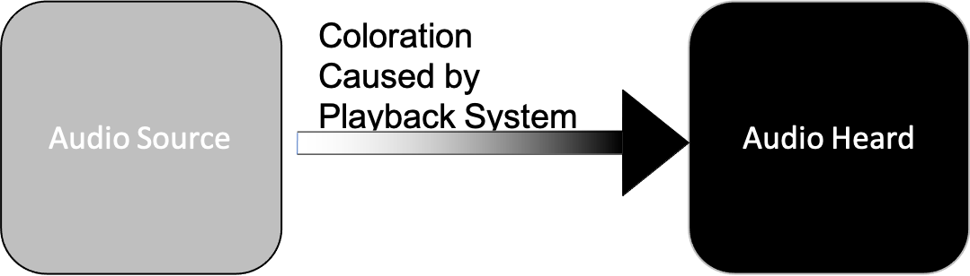
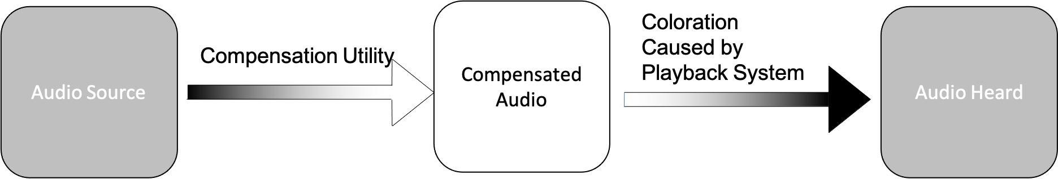
A Novel Inverse Filtering system
Uses Filtered Deconvolution to remove spectral changes that the room will impose from the recording before playback
Notes:
*******ADVANCE******ADVANCE******ADVANCE******ADVANCE******ADVANCE
My Inverse filtering system uses deconvolution to pre-process audio before playback to compensate for the room’s response.
*******ADVANCE******ADVANCE******ADVANCE******ADVANCE******ADVANCE
Here I’m showing the coloration applied by the playback system, the speakers, room, and DAC, as a darkening of the original audio (by which I don’t mean darkening as in a loss of high frequency but purely as a visual descriptor)
*******ADVANCE******ADVANCE******ADVANCE******ADVANCE******ADVANCE
When using my inverse filtering system, I process the audio source to reduce the characteristics that the playback system will accentuate prior to playing back the audio, so that the darkening process happens on an already lightened version of the audio source, so the audio heard is identical to the original audio

Slide 16
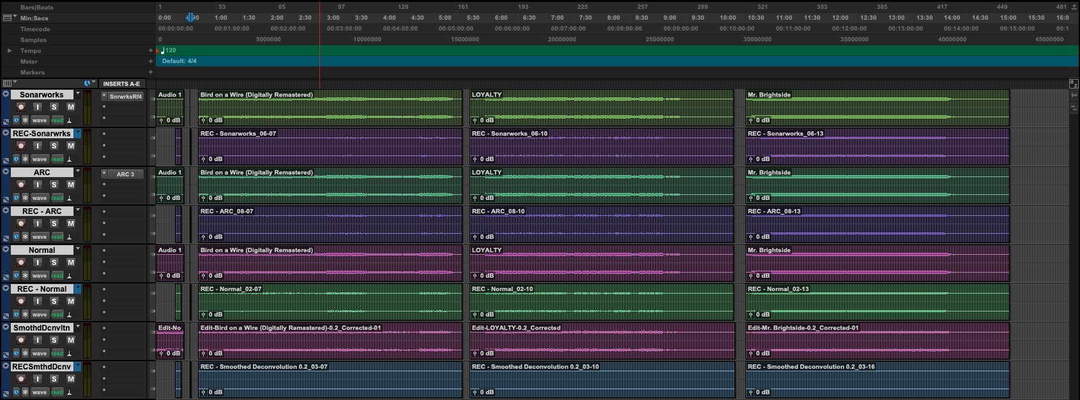
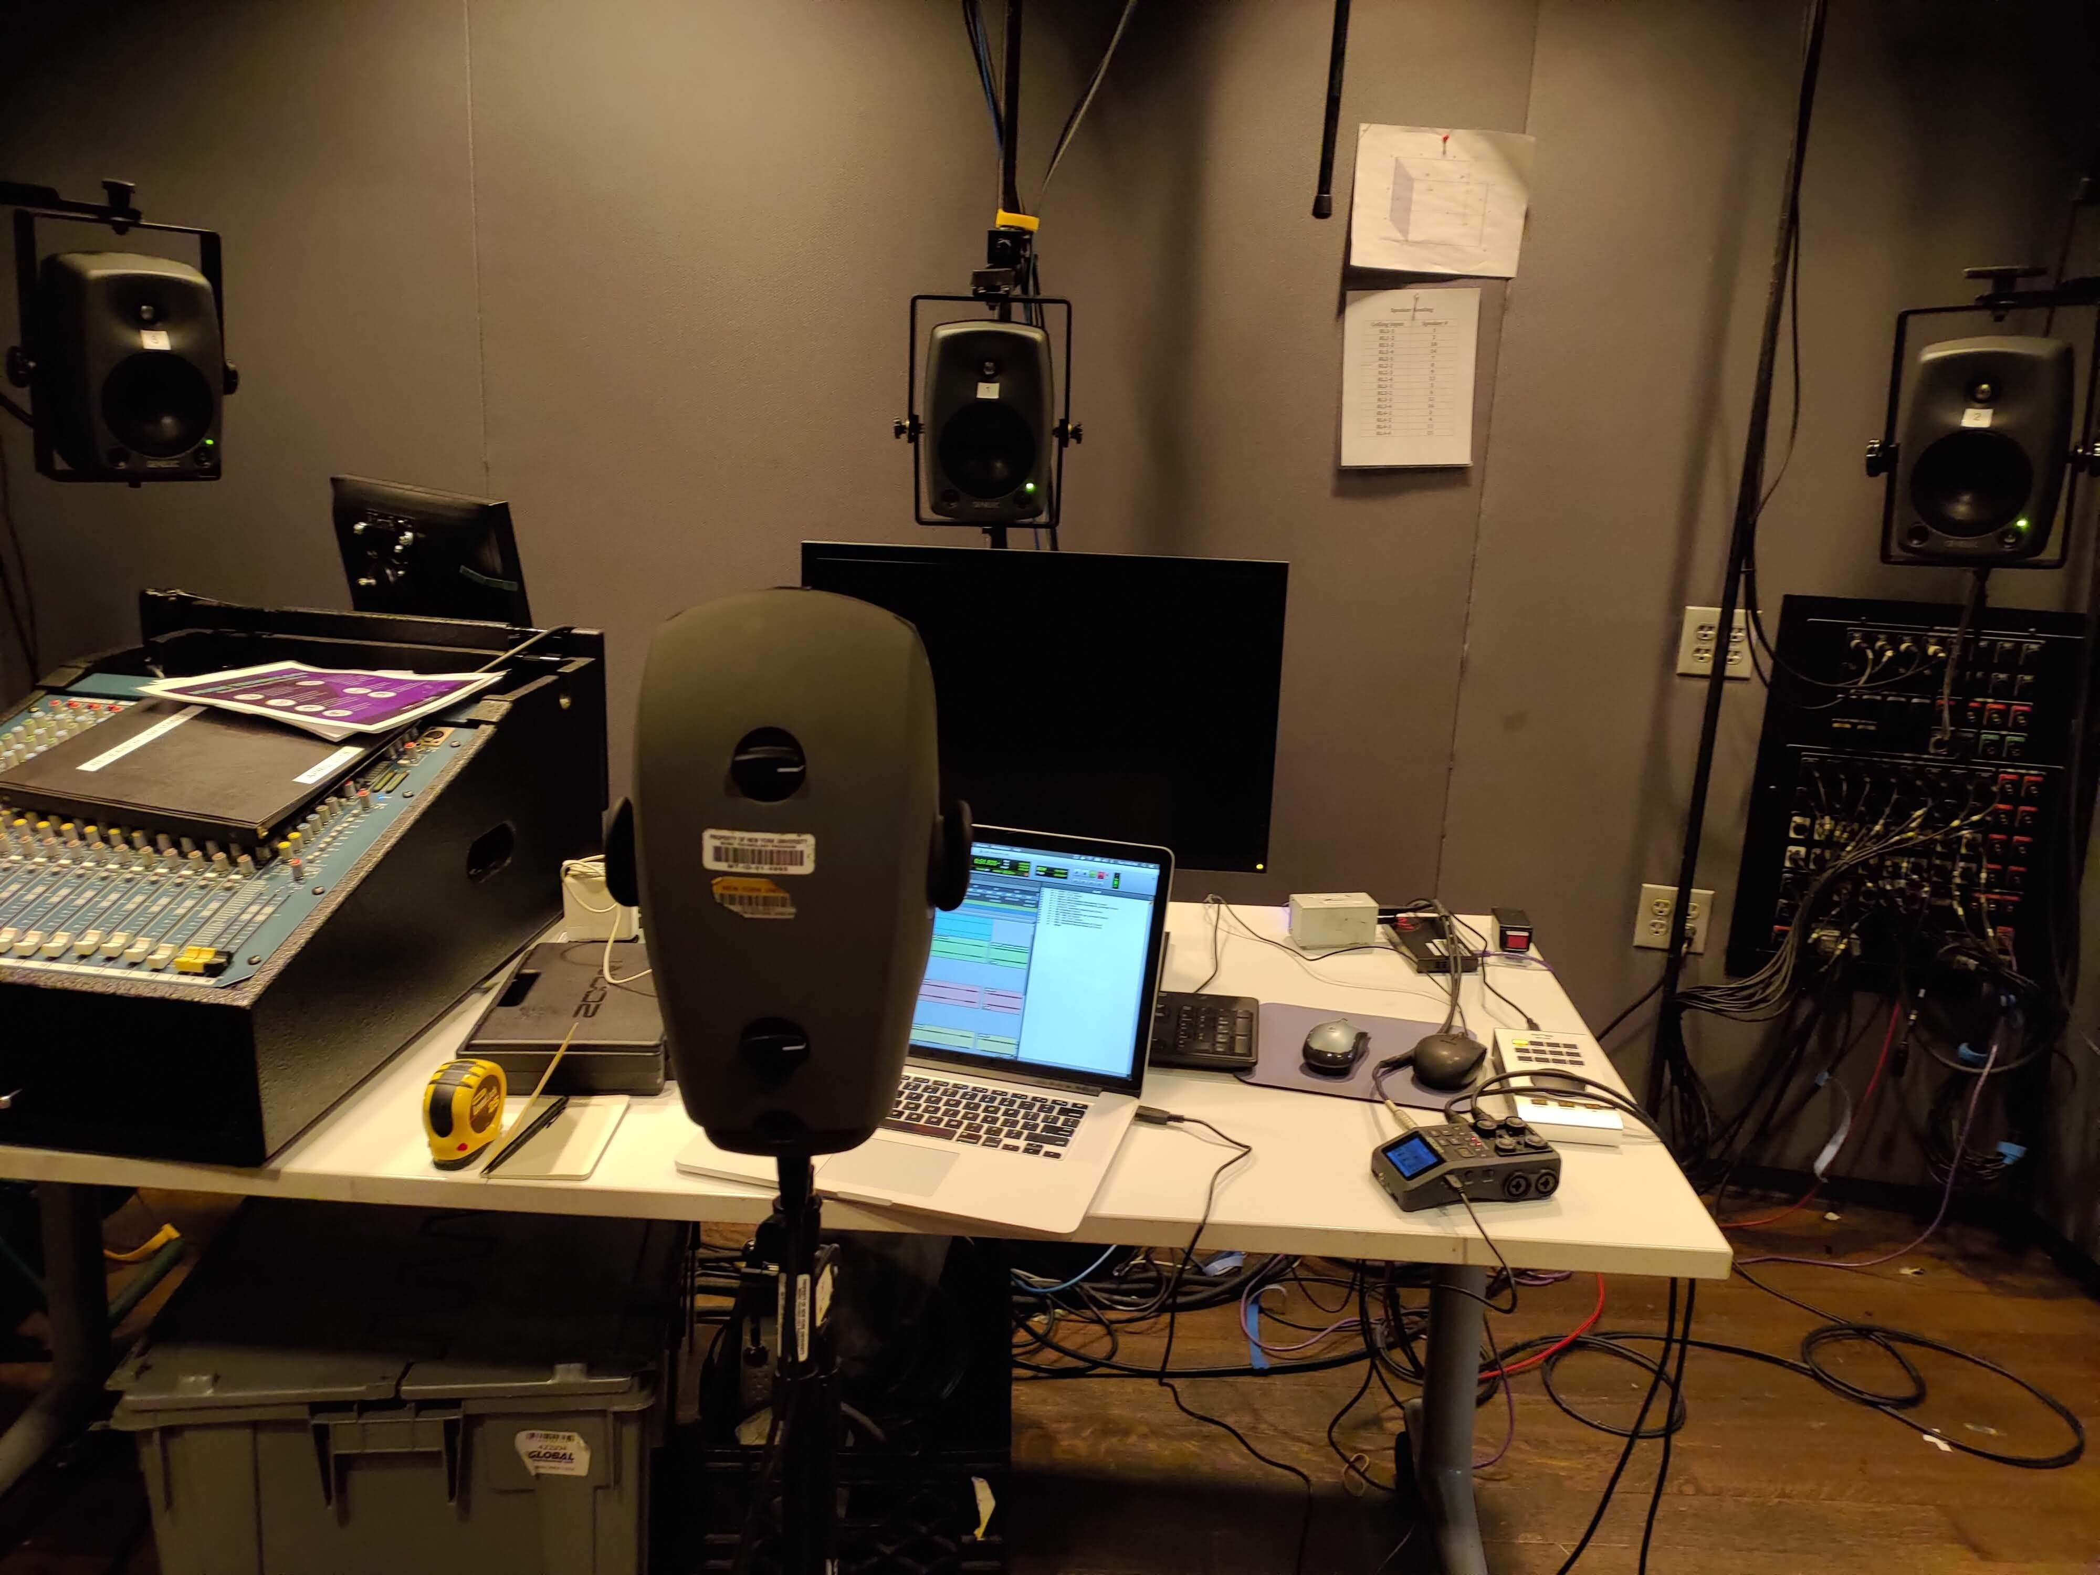
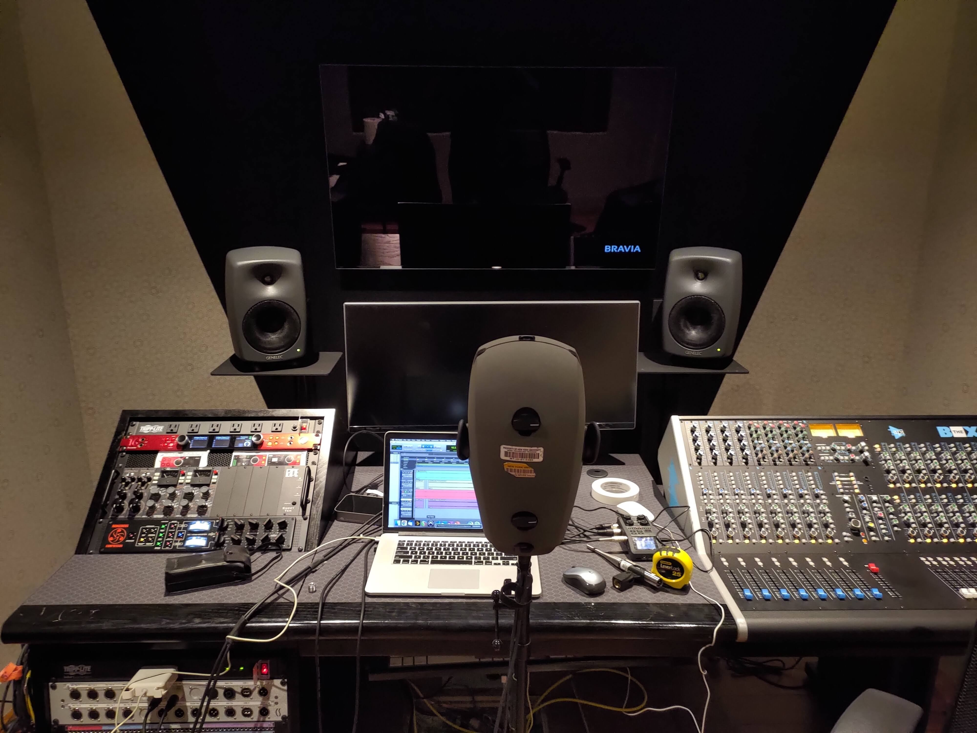
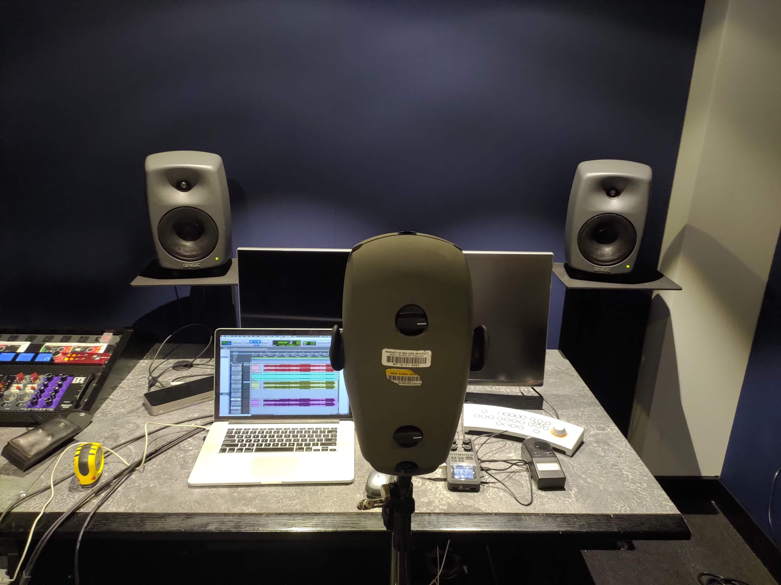
Recording Process
Notes:
To collect the impulse responses and Musical Exerpts in each room, I first went through the setup process for Sonarworks, for ARC, and for My system (which was different since it meant recording an impulse response of the room and processing all of the audio offline), then created a Pro Tools session for each room with 4 playback tracks. These were:
*******ADVANCE******ADVANCE******ADVANCE******ADVANCE******ADVANCE
Sonarworks, which was just the source material (Sine Sweep for Collecting the impulse response and the musical exerpts), with the Sonarworks Plugin inserted on the Track
*******ADVANCE******ADVANCE******ADVANCE******ADVANCE******ADVANCE
ARC, which was the same thing but with the ARC System 3 plugin on the track instead of Sonarworks
*******ADVANCE******ADVANCE******ADVANCE******ADVANCE******ADVANCE
Inverse, which contained the source material processed by the inverse filtering system prior to being put on the track.
*******ADVANCE******ADVANCE******ADVANCE******ADVANCE******ADVANCE
Normal-, which was simply the source material without any further processing
I then played back these 4 tracks one at a time,
*******ADVANCE******ADVANCE******ADVANCE******ADVANCE******ADVANCE
recording each to a new track in pro tools using the
*******ADVANCE******ADVANCE******ADVANCE******ADVANCE******ADVANCE
KU-100 Dummy head microphone and a Zoom H6 interface capturing each correction system’s performance in the room.

Slide 17

Processed Musical Excerpts
Notes:
I then used matlab to process, Split, and loudness normalize the recordings, as well as to deconvolve the sine sweeps into impuse responses.
Here is a quick demo of the processed musical exerpts from one of the rooms. The video will play 10 seconds of each processing system, first just displaying a number signifying the system, then displaying the name.
*******ADVANCE******ADVANCE******ADVANCE******ADVANCE******ADVANC

Slide 18
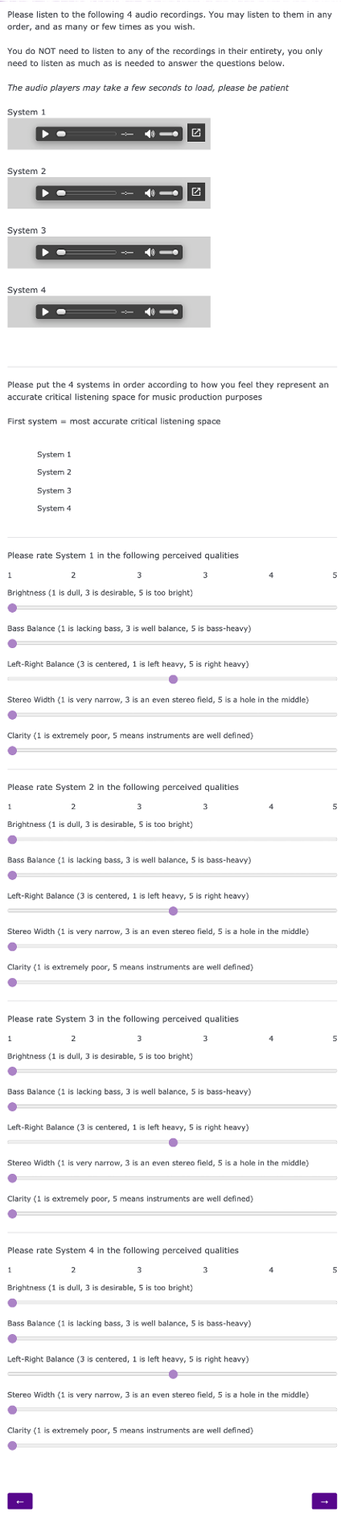
Survey
Notes:
I then uploaded all the musical excerpts to google drive and embedded them into a qualitrics survey that is shown here.
The listener was asked to listen to the audio examples and rank them according to how they felt each represented an accurate critical listening space for music production, and were then asked to rate each system on a five point scale on the 5 qualities.
My survey participants were 5 expert listeners (those who have worked on 1 or more grammy nominated productions).
Because I had such a small number of participants, I wasn’t able to draw hard mathematical conclusions from my results, but I’ll will make some general observations about the responses.

Slide 19
Evaluation
Preference Rating for Rankings
Boxplots for Ratings
Frequency Response and Delta Frequency Response plots for Impulse Responses
Notes:
For My evaluation,
*******ADVANCE******ADVANCE******ADVANCE******ADVANCE******ADVANCE
I took the rankings and applied point values to each position (4 points for 1st place, 3 points for 2nd place, and so on) and divided the number of points by the maximum number of points to get the preference rating here.
*******ADVANCE******ADVANCE******ADVANCE******ADVANCE******ADVANCE
For the characteristic ratings, I plotted them as box plots, omitting the Left-Right Balance question due to an imbalance in the KU-100 when recording which skewed those results towards lower values. Since all evaluations used the same system, all results were equally affected, so the comparison between systems in all other areas was unaffected.
*******ADVANCE******ADVANCE******ADVANCE******ADVANCE******ADVANCE
I created a few python functions that would plot my impulse responses and also generate difference plots showing both how each correction system differed from the uncorrected room response (essentially generating IMPOSED eq curves for the room) and how they differed from one another.
I will not be going into the Correction system difference plots in the following slides since they are just an easier way to see the differences between the 3 correction systems depicted in the imposed EQ curve plots

Slide 20
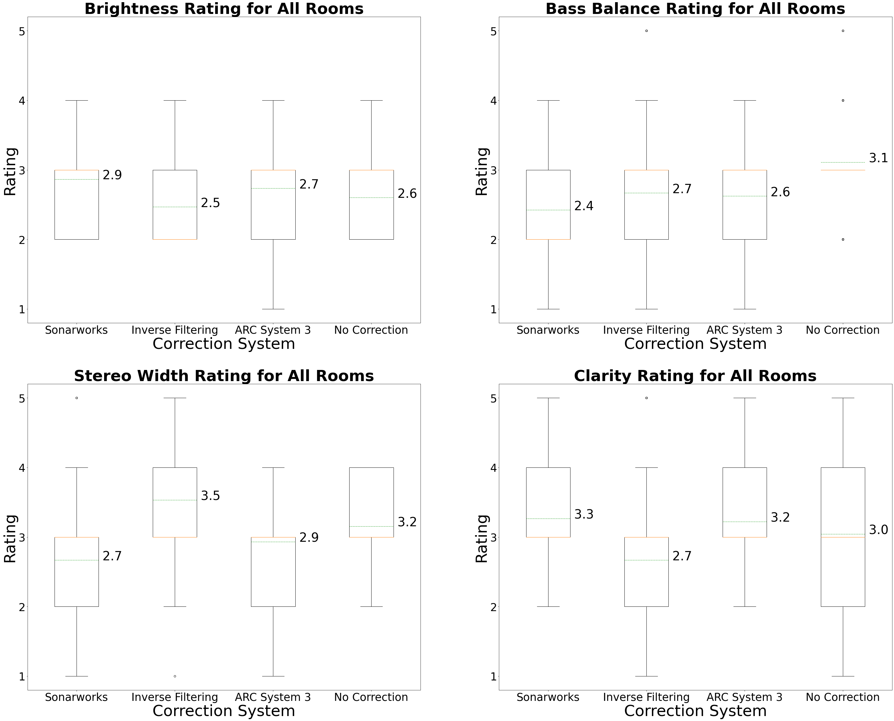
Data Collected Across All Rooms
 | Total - Preference Rating
Sonarworks | 28.0
Inverse | 18.4
ARC | 26.7
Normal | 26.9
Notes:
Across All Rooms, Sonarworks was most preferred, followed by the normal room response, then ARC, then the Inverse Filtering system.
It’s best to evaluate the frequency responses and characteristic ratings on a per-room basis, so lets look at the rooms one by one now.

Slide 21
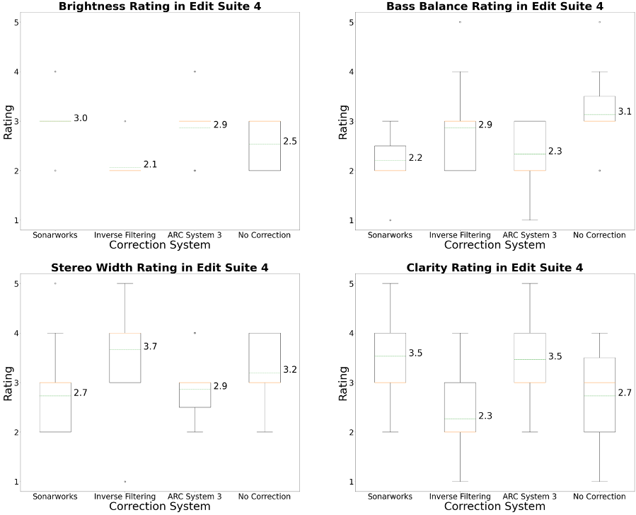
Edit Suite 4 – Rankings and Ratings
 | Edit Suite 4 - Preference Rating
Sonarworks | 30.0
Inverse | 14.0
ARC | 32.7
Normal | 23.3
Notes:
In Edit Suite 4 specifically, ARC was actually most preferred, followed by Sonarworks and then the normal room response, with the Inverse Filtering system taking up last place.
Looking at the ratings,
*******ADVANCE******ADVANCE******ADVANCE******ADVANCE******ADVANCE
The brightness ratings for the 3 correction systems had the smallest spread in results, with a lack of a box indicating identical median, 1st quartile, and 3rd quartile values. That value is higher for Sonarworks and ARC than for the Inverse filtering system, and Sonarworks and ARC’s value was higher than the 1st quartile value for No Correction, which had a larger spread than any of the 3 correction systems.
*******ADVANCE******ADVANCE******ADVANCE******ADVANCE******ADVANCE
In general the inverse filtering system received the worst scores.
*******ADVANCED******ADVANCED******ADVANCED******ADVANCED******ADVANCE

Slide 22
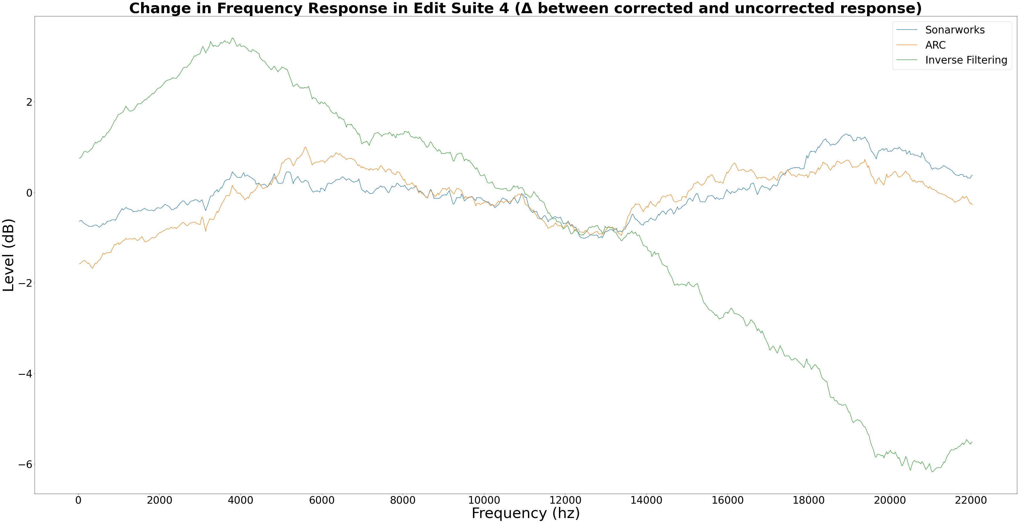
Edit Suite 4 – Frequency Response
Notes:
And here we can kinda see why!
*******ADVANCE******ADVANCE******ADVANCE******ADVANCE******ADVANCE
The Inverse filtering system significantly boosted the low end of the spectrum up to 4Khz,
*******ADVANCE******ADVANCE******ADVANCE******ADVANCE******ADVANCE
then sloped down pretty continuously until Nyquist
Sonarworks and ARC both
*******ADVANCE******ADVANCE******ADVANCE******ADVANCE******ADVANCE
cut the Low end,
*******ADVANCE******ADVANCE******ADVANCE******ADVANCE******ADVANCE
boosted around 4-8 Khz,
and also
*******ADVANCE******ADVANCE******ADVANCE******ADVANCE******ADVANCE
boosted from ~14Khz up to ~20Khz

Slide 23
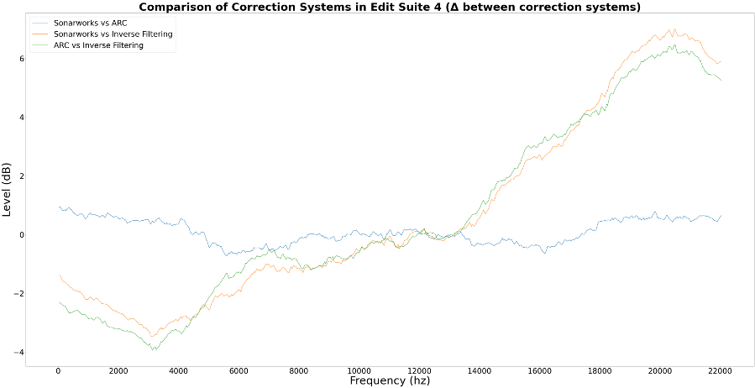
Edit Suite 4 – Frequency Response
Notes:
If we switch to the correction system comparison plot, we can more easily see the differences in processing between the 3 correction systems.
Again, we can see that ARC and Sonarworks were very similar. Their comparison is the
*******ADVANCE******ADVANCE******ADVANCE******ADVANCE******ADVANCE
Blue line, which is nearly flat denoting that difference between the two systems response was very minimal.
Sonarworks
*******ADVANCE******ADVANCE******ADVANCE******ADVANCE******ADVANCE
did cut less of the bass frequencies than ARC but cut more of the upper ranges, specifically between
*******ADVANCE******ADVANCE******ADVANCE******ADVANCE******ADVANCE
5 and 6 k and 14 and 17 k.
*******ADVANCE******ADVANCE******ADVANCE******ADVANCE******ADVANCE
Like the previous plot, we can see the huge boosts and cuts made by the inverse filtering system but we can also see that the inverse filtering system matched ARC more than Sonarworks between ~6K and 8 K

Slide 24
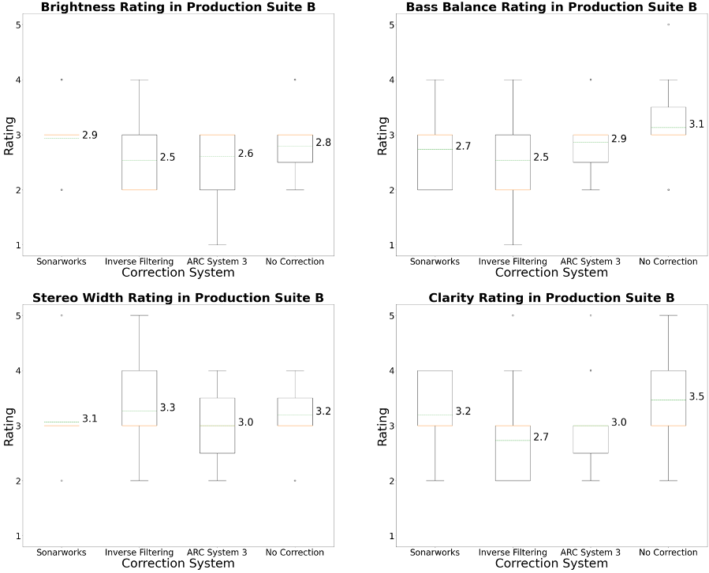
Production Suite B – Rankings and Ratings
 | Production Suite B - Preference Rating
Sonarworks | 32.7
Inverse | 15.3
ARC | 24.0
Normal | 28.0
Notes:
Looking at Production Suite B, Sonarworks was greatly preferred over either of the other two correction systems, with the normal Room response taking second place, and ARC and Inverse filtering taking 3rd and 4th.
*******ADVANCE******ADVANCE******ADVANCE******ADVANCE******ADVANCE
The brightness spread is different for Inverse Filtering and ARC compared to Edit Suite 4, and the highest ranked Sonarworks is the only one with such a narrow spread of results.
*******ADVANCE******ADVANCE******ADVANCE******ADVANCE******ADVANCE
Additionally the clarity ratings for Sonarworks reached higher values than ARC, and Inverse filtering had in general the largest spread of results.

Slide 25
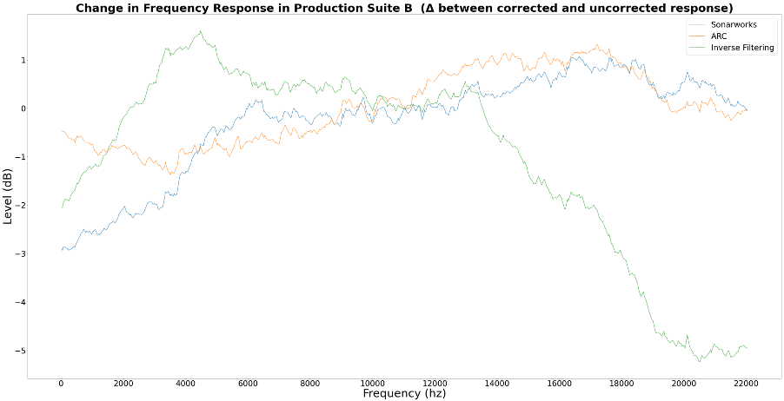
Production Suite B – Frequency Response
Notes:
The inverse filtering’s correction was less extreme than in Edit Suite 4, as you can see by the
*******ADVANCE******ADVANCE******ADVANCE******ADVANCE******ADVANCE
less extreme low frequency curve and the flatter line in the middle of the plot.
*******ADVANCE******ADVANCE******ADVANCE******ADVANCE******ADVANCE
All 3 systems cut the bass frequencies and remained mostly flat from ~5khz to ~12 Hz,
above which Sonarworks
*******ADVANCE******ADVANCE******ADVANCE******ADVANCE******ADVANCE
and ARC boosted
*******ADVANCE******ADVANCE******ADVANCE******ADVANCE******ADVANCE
and the inverse filtering system cut
*******ADVANCE******ADVANCE******ADVANCE******ADVANCE******ADVANCE
You can also see that the low frequency slope of Sonarworks was greater than that of ARC, where the induced EQ was more gradual.

Slide 26
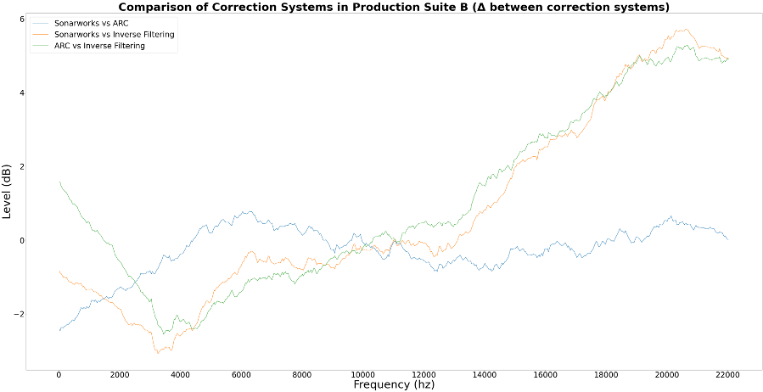
Production Suite B – Frequency Response
Notes:
Again the Inverse Filtering system was the outlier and Sonarworks and ARC were mostly similar, but much less so than in Edit Suite 4.
In particular on the low end the two systems differed, where Sonarworks
*******ADVANCE******ADVANCE******ADVANCE******ADVANCE******ADVANCE
had a deeper and sharper cut than ARC.
The relative flatness of the VS Inverse Filtering lines in
*******ADVANCE******ADVANCE******ADVANCE******ADVANCE******ADVANCE
these two frequency ranges indicate that the inverse filtering system performed similarly to ARC and Sonarworks compared to the rest of the frequency range, but with an overall boost or cut across that range

Slide 27
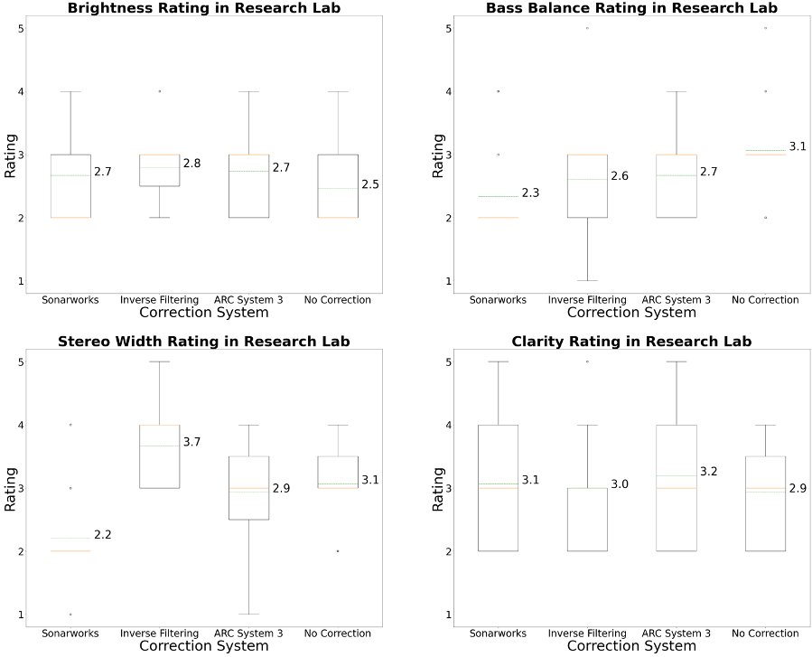
Research Lab – Rankings and Ratings
 | Research Lab - Preference Rating
Sonarworks | 21.3
Inverse | 26.0
ARC | 23.3
Normal | 29.3
Notes:
The last room, the Immersive Audio Research Lab at 35 West 4th street, was probably the most interesting in terms of results.
In this room, The uncorrected room response was actually the most preferred “Correction System”, which was followed by the Inverse filtering system, which up until now has always been ranked worst. ARC was next and finally, Sonarworks took up last place.
This was surprising both because it is the only room in which a correction system was not preferred over the uncorrected room response and because it is the only room where the inverse filtering system was preferred over either of the commercial systems.
*******ADVANCE******ADVANCE******ADVANCE******ADVANCE******ADVANCE
In terms of quality ratings, the only thing that jumps out is that Inverse Filtering had a smaller 1st to third quartile spread of results In brightness and clarity compared to the other 3 systems

Slide 28
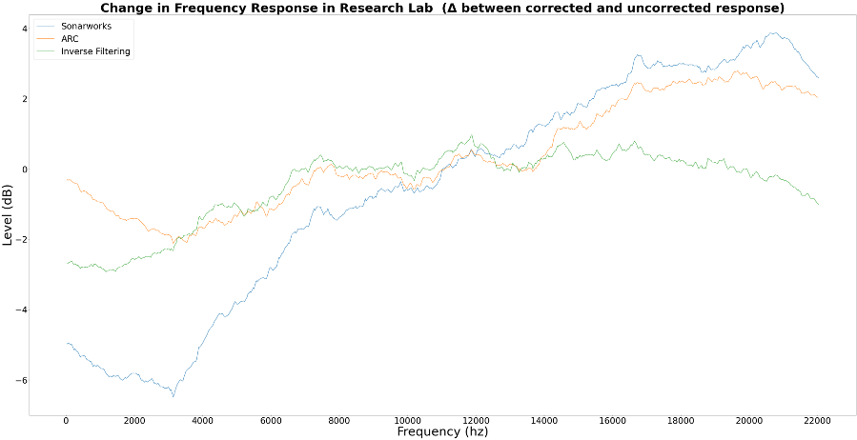
Research Lab – Frequency Response
Notes:
Looking at the change in frequency response,
*******ADVANCE******ADVANCE******ADVANCE******ADVANCE******ADVANCE
Now the inverse filtering system is pretty flat, and
*******ADVANCE******ADVANCE******ADVANCE******ADVANCE******ADVANCE
Sonarworks’ curve is extreme.
Sonarworks has a
*******ADVANCE******ADVANCE******ADVANCE******ADVANCE******ADVANCE
massive bass cut and a large high frequency boost, while
*******ADVANCE******ADVANCE******ADVANCE******ADVANCE******ADVANCE
ARC doesn’t cut much bass but has a similar high frequency boost.
*******ADVANCE******ADVANCE******ADVANCE******ADVANCE******ADVANCE
The Inverse filtering system cut the bass by a little more than 2db and made some small cuts and boost throughout the rest of the range, but was mostly flat.

Slide 29
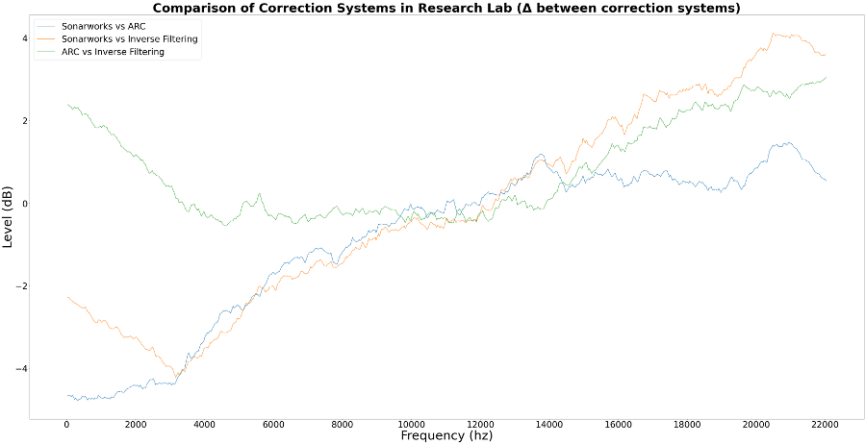
Research Lab – Frequency Response
Notes:
Starting with the low end, we can see that ARC and Sonarworks
*******ADVANCE******ADVANCE******ADVANCE******ADVANCE******ADVANCE
processed the low frequencies similarly, but at different levels (meaning the eq curve was the same, but offset in level) **show with hands**
*******ADVANCE******ADVANCE******ADVANCE******ADVANCE******ADVANCE
The flat line between 4Khz and 14Khz shows that ARC and the Inverse Filtering system had nearly identical processing in those ranges, until
*******ADVANCE******ADVANCE******ADVANCE******ADVANCE******ADVANCE
ARC started boosting around 14Khz while the Inverse Filtering System did not.

Slide 30
What does that all mean?
Inverse Filtering system did not perform well
In general, the more preferred systems were often better rated in brightness and clarity.
Extreme Processing was always least preferred
Each room’s preference ranking varied greatly.
Notes:
That was a lot of data. So what does it all mean?
*******ADVANCE******ADVANCE******ADVANCE******ADVANCE******ADVANCE
The inverse filtering system did not perform well overall. While it performed ok in the Research Lab, it performed so poorly in Edit Suite 4 and Production Suite B that I would not recommend it for use in room correction in it’s current form.
*******ADVANCE******ADVANCE******ADVANCE******ADVANCE******ADVANCE
The more preferred systems appeared to generally receive better ratings in terms of brightness and clarity, but I can’t say the two are actually correlated since I had such a small dataset.
*******ADVANCE******ADVANCE******ADVANCE******ADVANCE******ADVANCE
Frequency response or Imposed EQ curve flatness was not a direct indicator of user preference, although the extreme imposed EQ curves by the inverse filtering system in Edit Suite 4 and Production suite B and by Sonarworks in The research lab were the least preferred systems in those rooms
*******ADVANCE******ADVANCE******ADVANCE******ADVANCE******ADVANCE
Each room’s preference ranking was pretty different. Each of the commercial correction systems was most preferred in one of the 3 rooms, and in the other the uncorrected room was most preferred with the Inverse Filtering system (which was generally least preferred) taking second place.

Slide 31
Why does it matter?
Binaural Testing worked well
One System does not rule them all
Automated Software can make mistakes
Notes:
*******ADVANCE******ADVANCE******ADVANCE******ADVANCE******ADVANCE
I believe that the process that I laid out for recording and testing the corrected room response is particularly valuable. In future testing, I believe that this approach to recording content in corrected and uncorrected rooms can be used to increase the participant pool and allow actual concrete conclusions to be made.
*******ADVANCE******ADVANCE******ADVANCE******ADVANCE******ADVANCE
There was no “Clear Winner”, which isn’t really surprising when you think about it. The two commercial systems both have trials that an aspiring engineer or musician should take advantage of before purchasing any software based correction product.
*******ADVANCE******ADVANCE******ADVANCE******ADVANCE******ADVANCE
Automated systems make mistakes. We don’t have self-driving cars (yet) and we don’t have self-correcting rooms. I think the software will eventually get there, but it needs significant work.

Slide 32
What is next?
More Testing!!!
More Rooms
More Participants
Improve the Inverse Filtering System
Create Something that anyone can use
Run in real-time
Average the impulse responses
Improve the Smoothing system
Notes:
And finally What are my future goals for all of this
*******ADVANCE******ADVANCE******ADVANCE******ADVANCE******ADVANCE
I want to do more testing with more rooms to determine whether the room size was a factor in correction system performance, since each small critical listening room had a pretty different size.
Since all 3 rooms already had some amount of acoustic treatment, I think it would also be interesting to see how the correction systems perform in completely uncorrected rooms, such as dorm rooms or apartments.
More participants!
Testing online worked well despite Qualitrics’ extremely low file size limit which complicated the process by requiring me to upload the audio files to Google Drive, but I was able to reach more expert listeners than I would have had the testing been done in a physical location. I’d love to be able to draw strong conclusions from the survey results, and for that I’d need many more participants.
*******ADVANCE******ADVANCE******ADVANCE******ADVANCE******ADVANCE
I want to continue to improve the inverse filtering system
*******ADVANCE******ADVANCE******ADVANCE******ADVANCE******ADVANCE
My goal is to create an open source system similar to the commercial ones tested, and to do that I first need to rewrite it so that it can run as a DAW plugin.
*******ADVANCE******ADVANCE******ADVANCE******ADVANCE******ADVANCE
It’s not realistic as a utility in its current state, where the audio needs to be processed offline before the corrected audio can be listened to
*******ADVANCE******ADVANCE******ADVANCE******ADVANCE******ADVANCE
I need to collect and average multiple impulse responses. The setup for ARC and Sonarworks both require the microphone to be moved around to correct for a listening area rather than for a single point. While this wasn’t really an issue for my testing since the KU-100 stayed in the exact position that was corrected for, it would be an issue with a human listener in the corrected space
*******ADVANCE******ADVANCE******ADVANCE******ADVANCE******ADVANCE
I need to improve the smoothing system, which is derived from a smoothing function for deconvolution for testing architectural models by Dr. Erol Kalkan. I’d like to experiment with other smoothing functions for the inverse filter, like local average filtering or Savitzky-Golay filtering

